Slide 1
COVID-19 Local Health Department Dashboard Storytelling Project
Jason Messner, MPH
Health Data Analyst
CDC Foundation

Slide 2
Characters
Me, CDC Foundation Data Analyst
Local Michigan Health Department
Power BI
Python
Tableau
Michigan COVID-19 Case Dataset

Slide 3

What is the CDC Foundation?
Independent, nonprofit created by Congress to mobilize philanthropic and private-sector resources to support the CDC
1,200 health protection programs in the United States and over 160 countries
I work with the COVID-19 response program

Slide 4
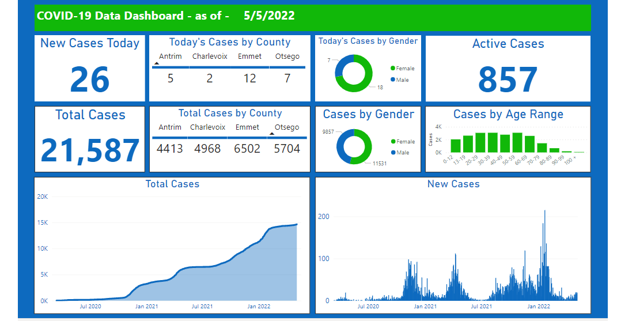
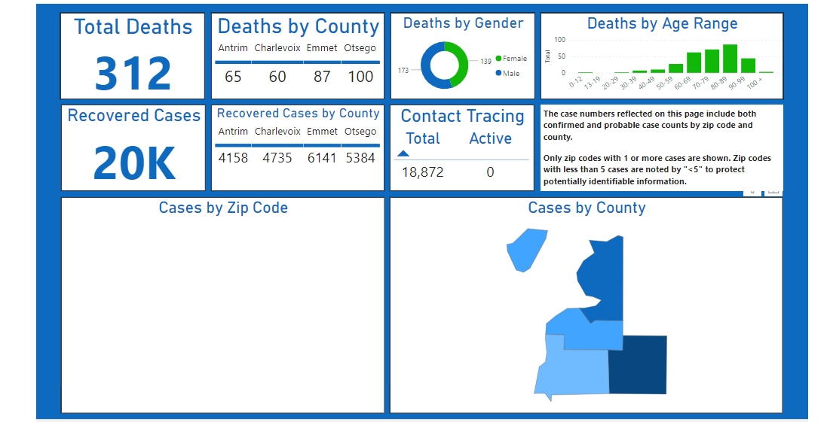
Prologue/Initial Problem
The Health Department of Northwest Michigan (HDNW) manually processes a COVID-19 dataset for its COVID-19 cases dashboard with Excel
The current dashboard (2 pages):

Slide 5
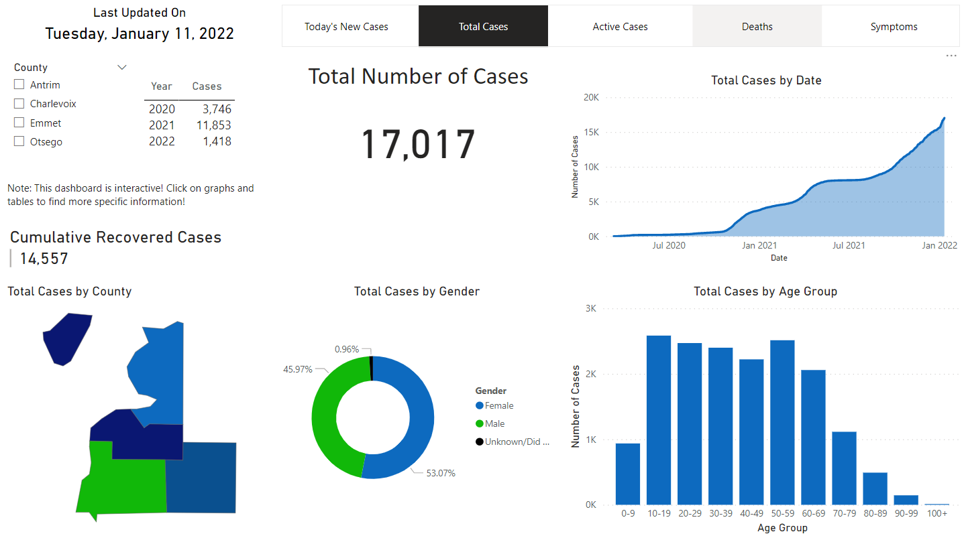
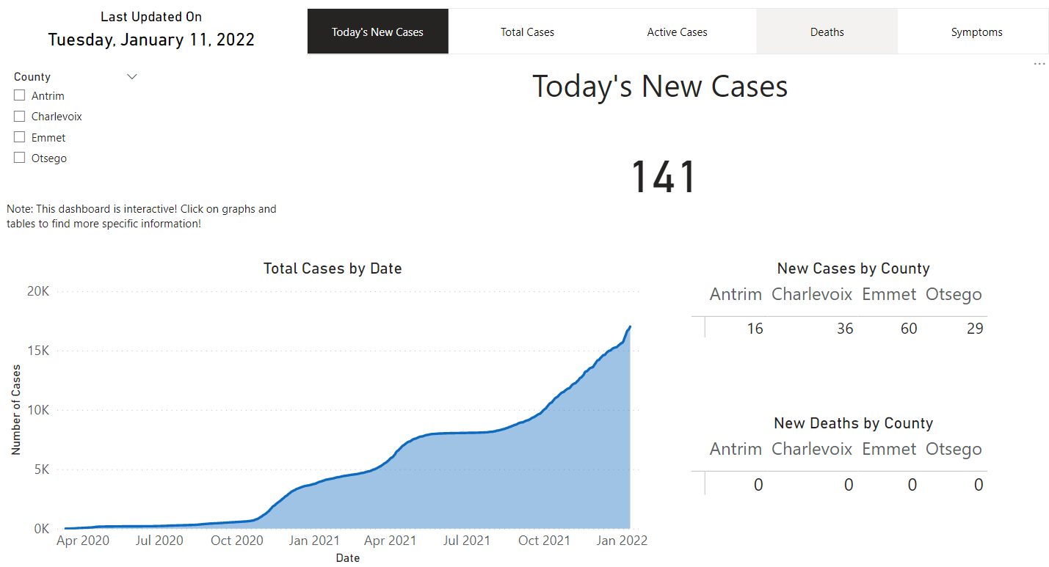
Prologue Continued
With the help of python(jupyter notebook) for data pre-processing, I automated and created a new interactive dashboard per HDNW guidance/requirements
Part of the dashboard is shown below:

Slide 6
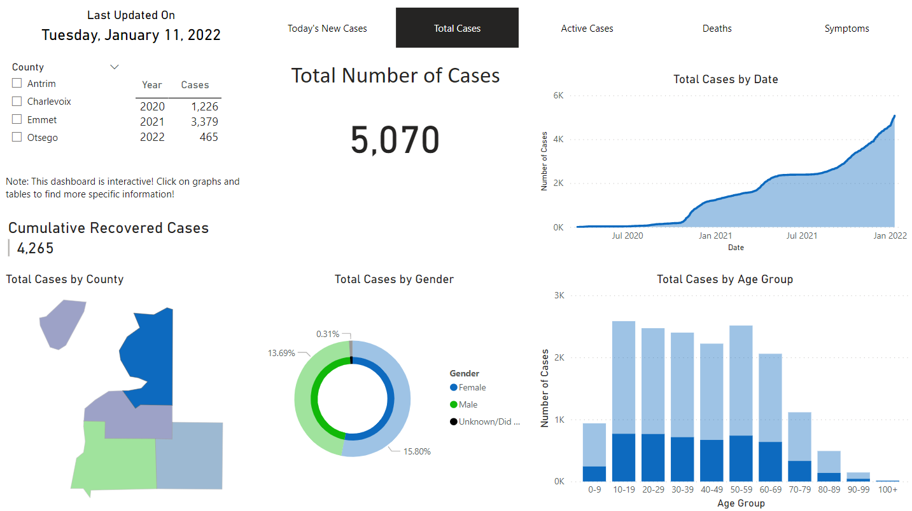
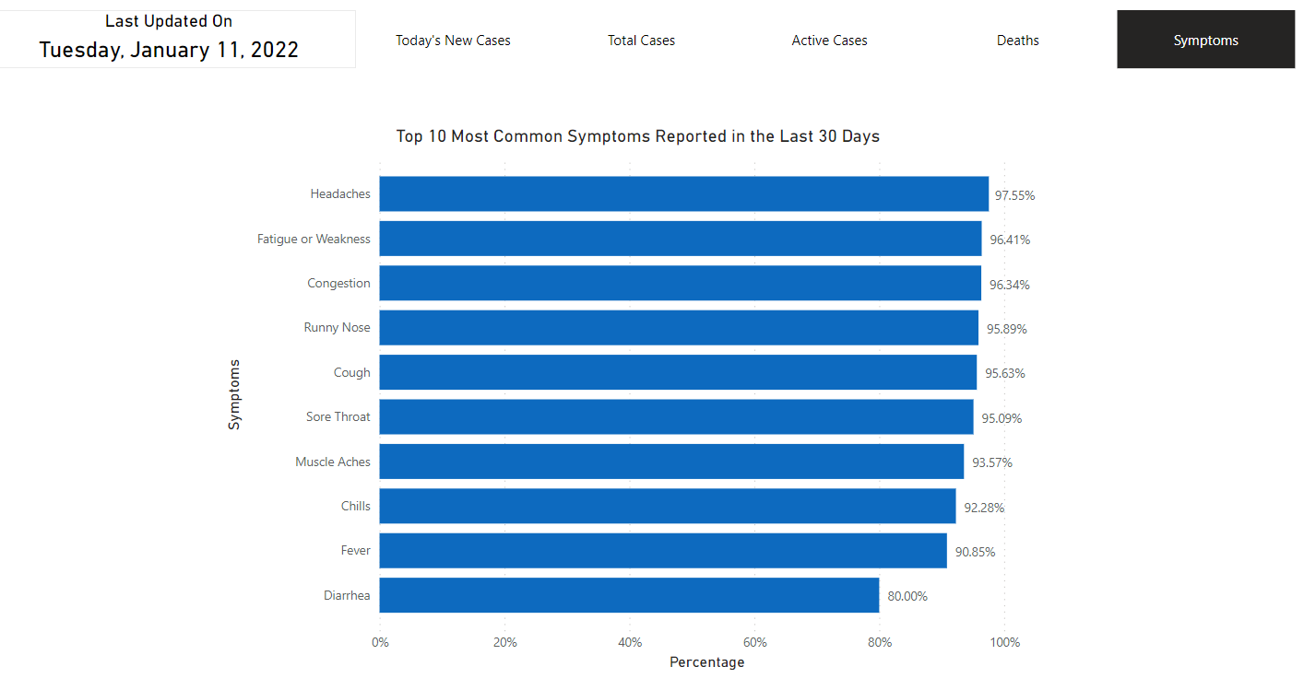
Dashboard Cont.

Slide 7
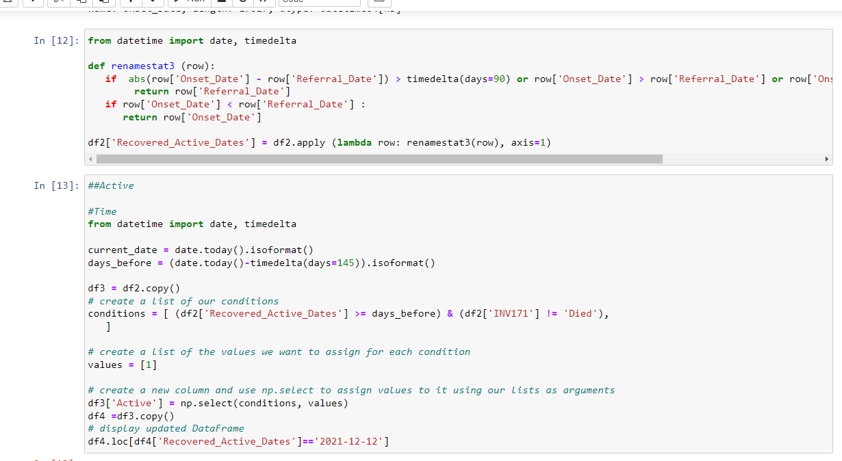
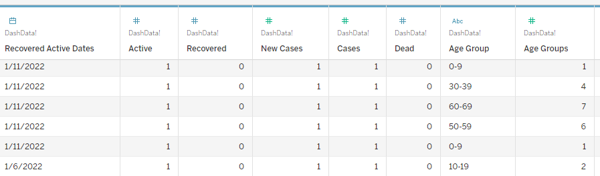
HDNW COVID Dataset
This dataset tracks COVID-19 cases in the four Michigan counties that HDNW serves: Charlevoix, Emmet, Antrim, and Otsego
The dataset used in this project dates from January 11, 2022
17,011 rows and over 50 columns
Many null or empty cells
With python/jupyter notebook, I preprocessed this dataset
Identifying recovered/active cases based on available onset or referral date data
Creating age group bins and defining deceased cases
Aggregating symptom responses to get percentages of answers such as 93% of respondents experienced symptom X

Slide 8
Main Issue
I was required to use Power BI but not all organizations use Power BI
Many organizations prefer to use Tableau
Can I utilize Tableau to create visualizations like the visualizations I created with Power BI and perhaps make them more informative?
Can Tableau’s unique capabilities lead me to new insights related to preprocessing and the data itself?

Slide 9
Time for Visualization Exploration

Slide 10
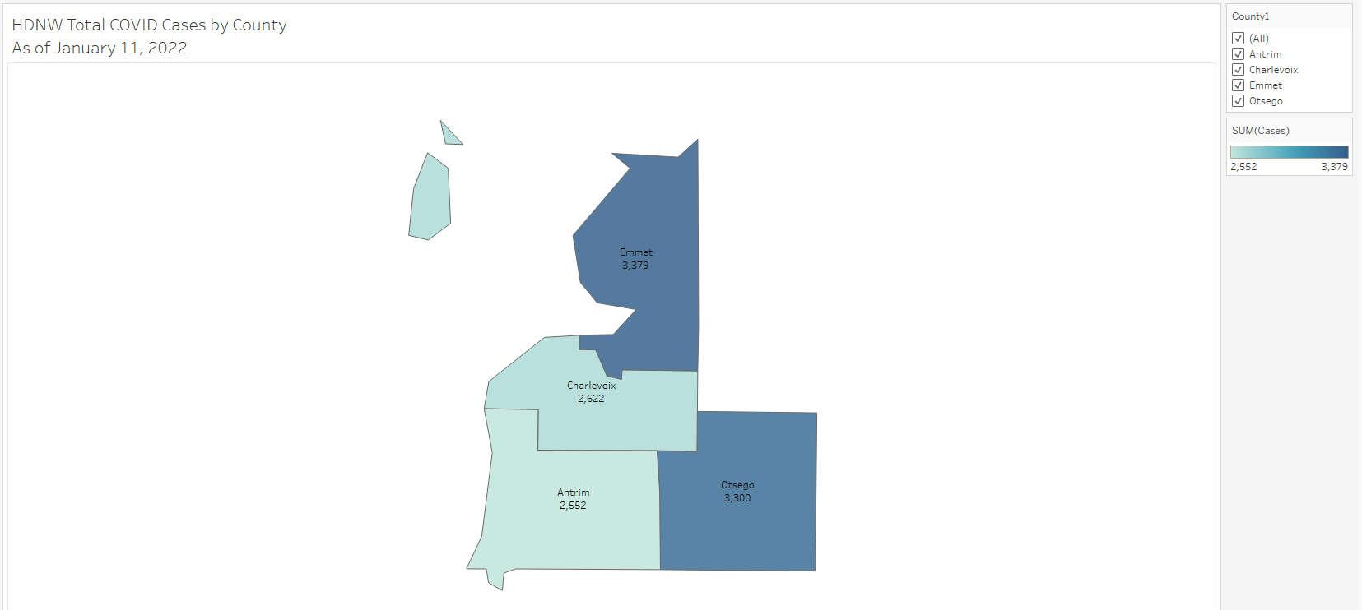
Sum of Total Cases Map with Color Indicator
Tableau’s mapping capabilities are fair easier to use vs Power BI for the purpose of creating this type of map graphic.

Slide 11
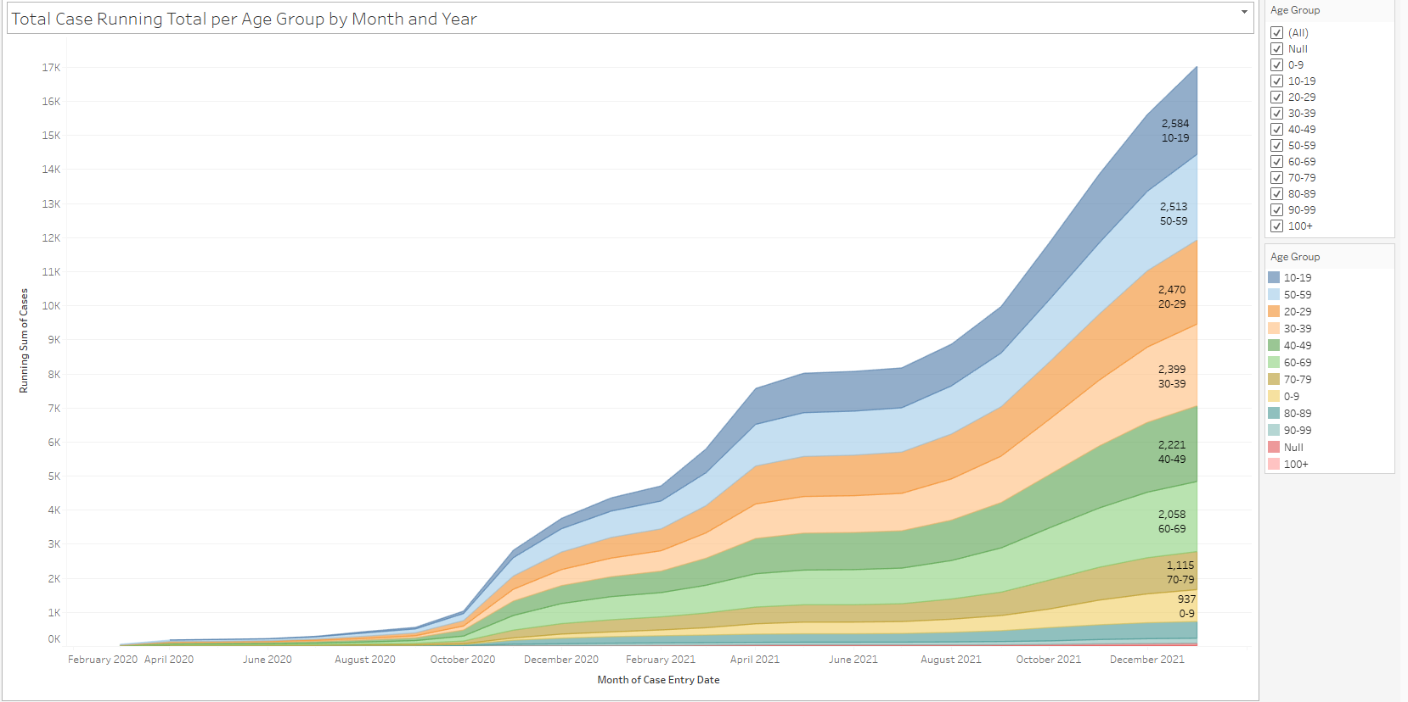
Case Running Total per Age Group by Month and Year
Too many groups for this kind of graphic?

Slide 12
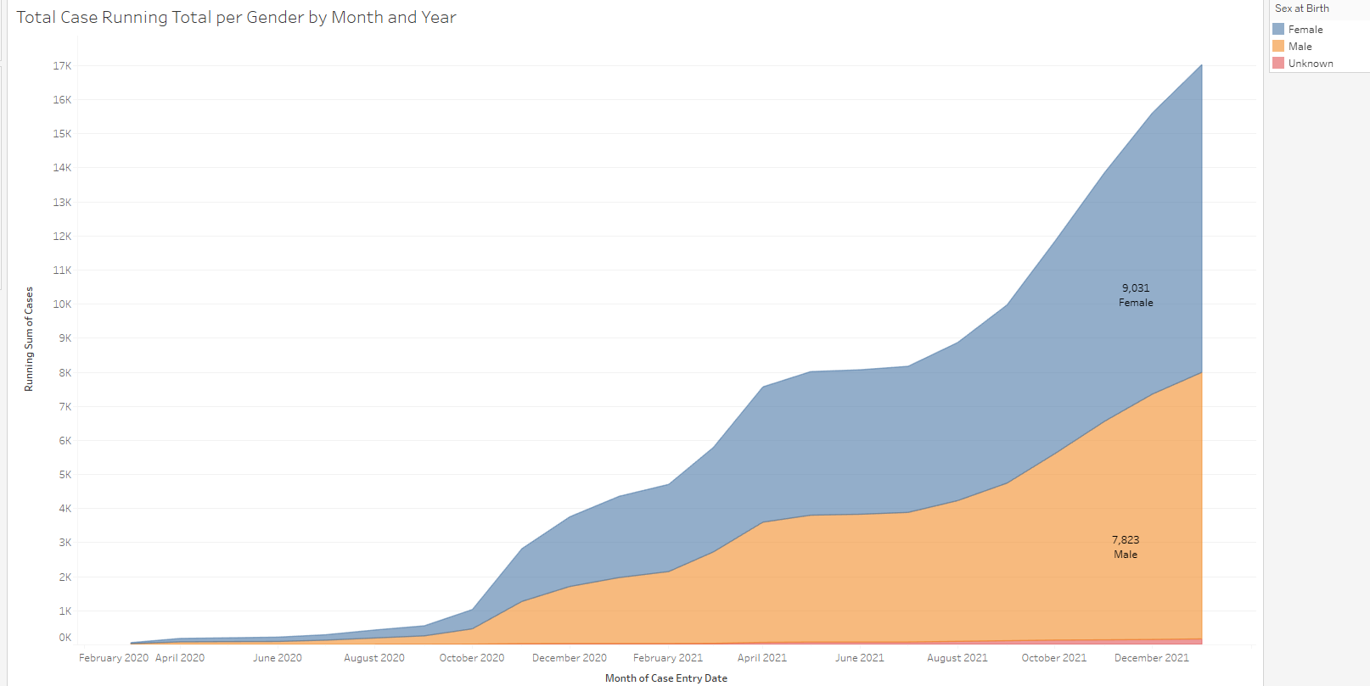
Total Case Running Total per Gender by Month/Year
This graphic shows a clear difference between genders!

Slide 13
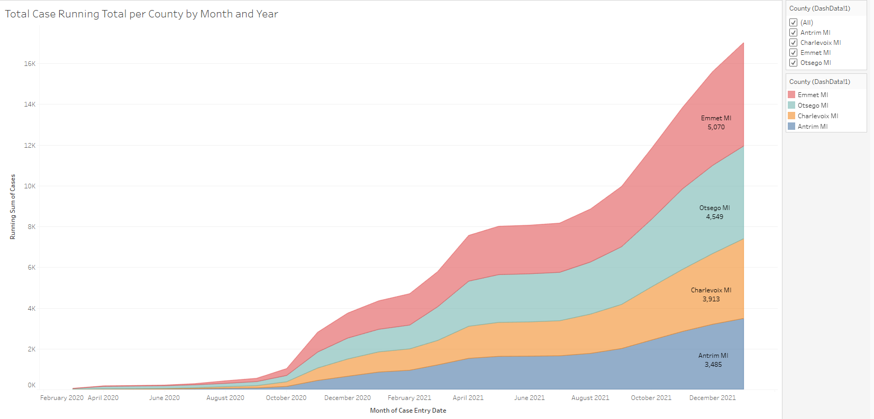
Total Case Running Total per County
Not bad!

Slide 14
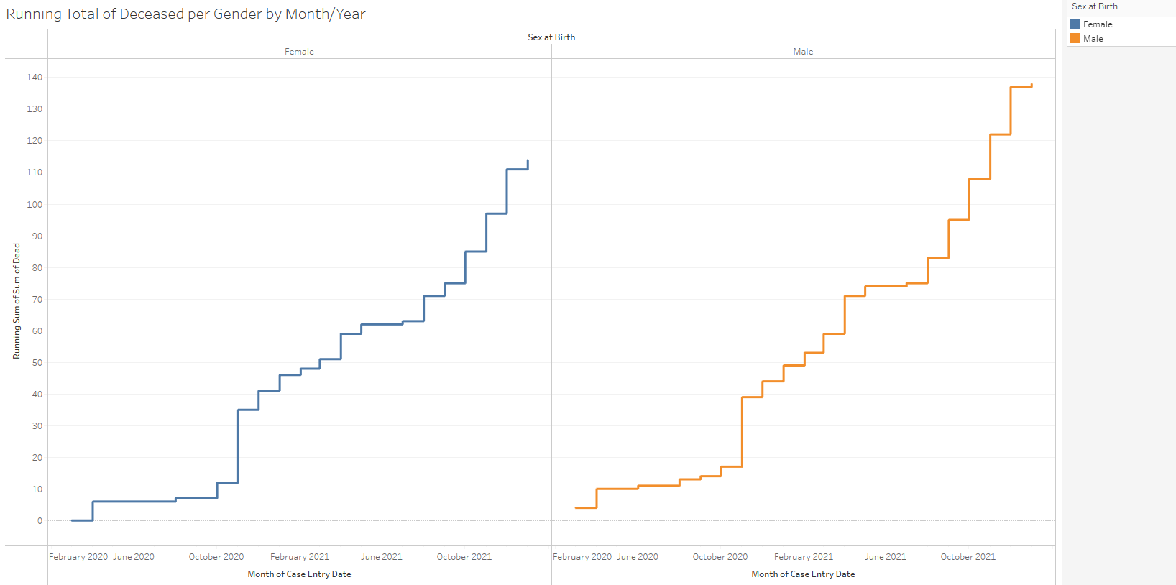
Running Total of Deceased per Gender by Month/Year
Clear difference in gender deaths around October 2021

Slide 15
In the middle of exploration, I discovered a preprocessing error!

Slide 16
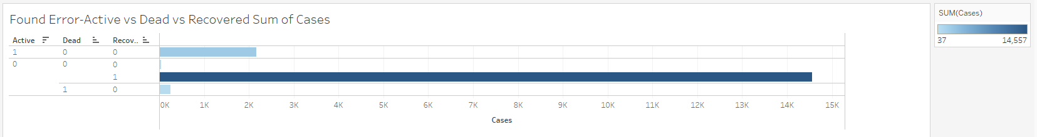
Error with Preprocessing

Slide 17
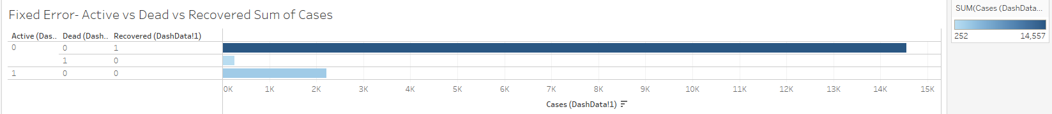
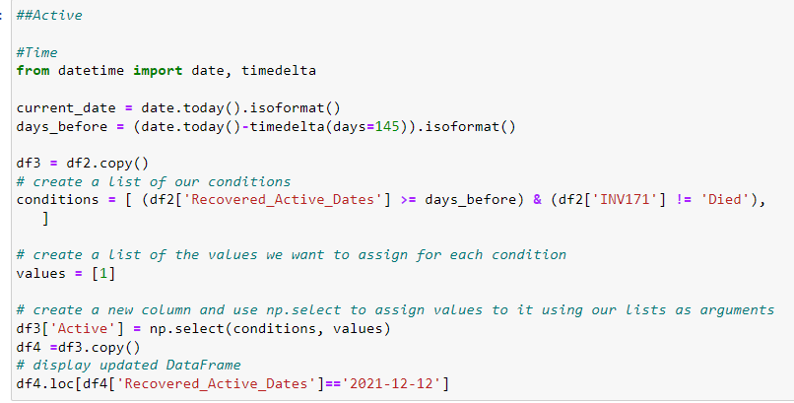
Error Fixed

Slide 18
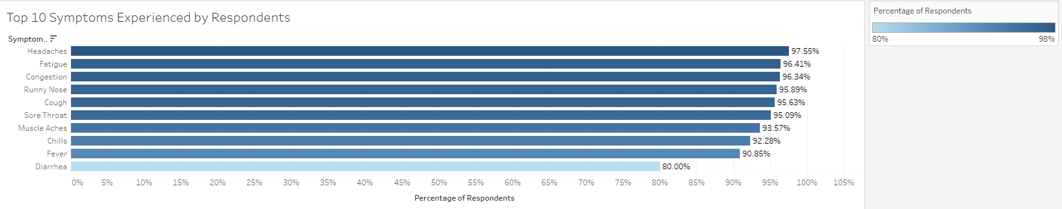
Top 10 Symptoms Experienced by Respondents

Slide 19
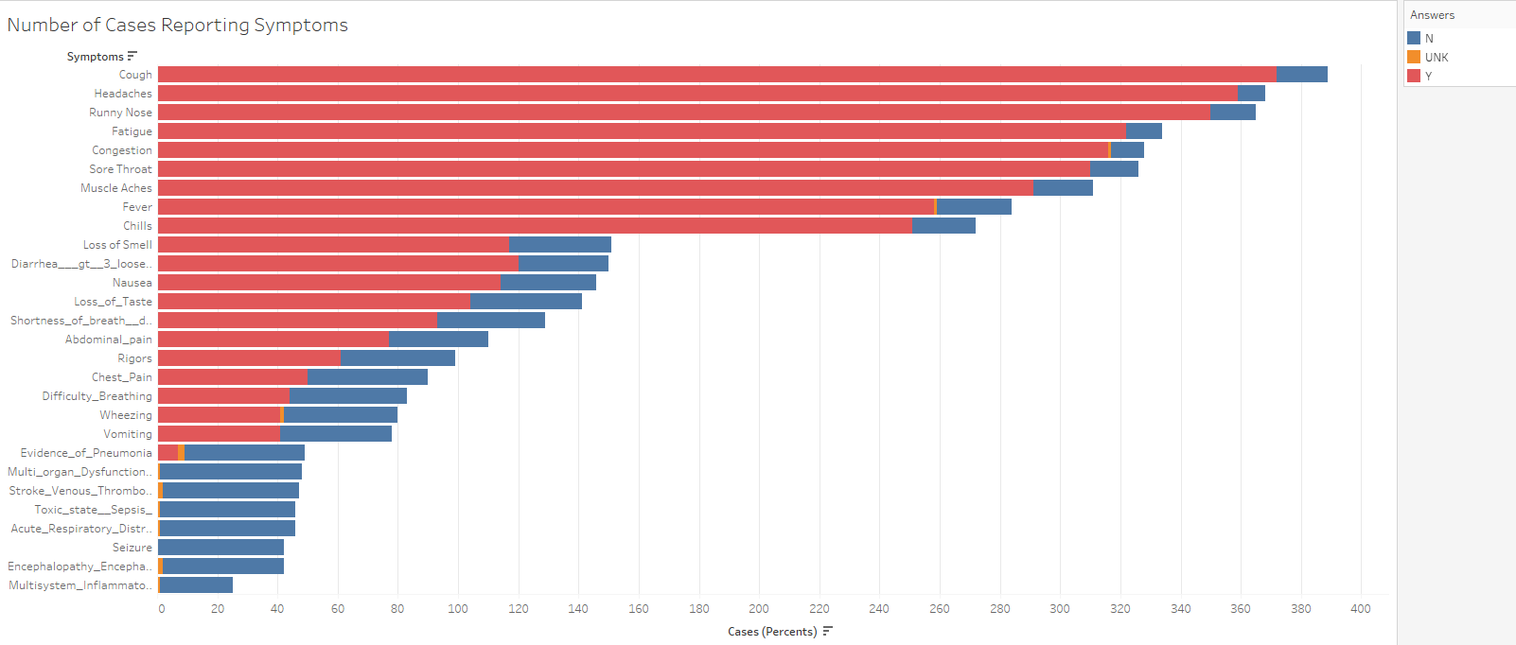
Number of Cases Reporting Symptoms

Slide 20
Next, I examined Deaths/Cases!

Slide 21
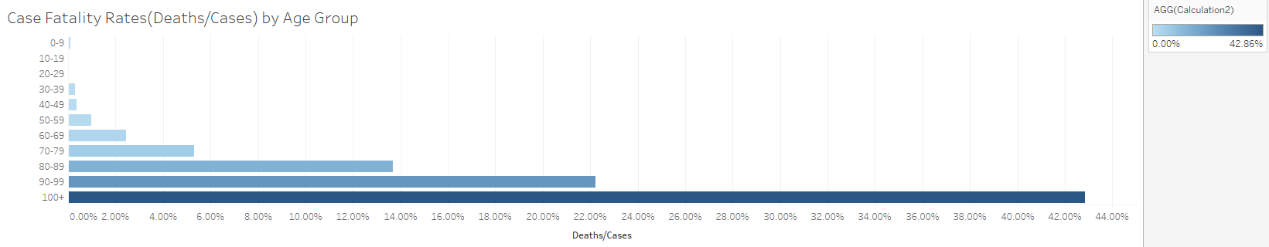
Case Fatality Rates by Age Group

Slide 22
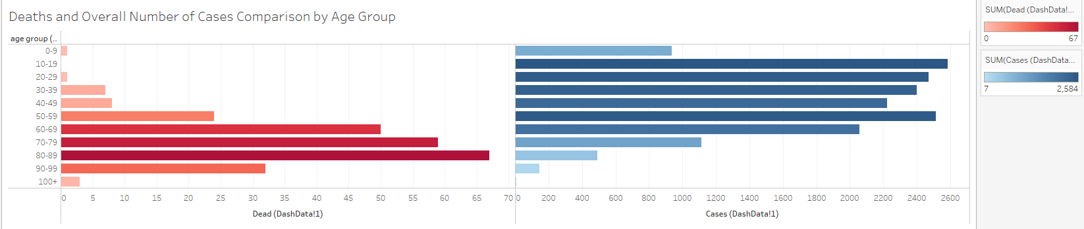
Deaths and Overall Number of Cases Comparison by Age Group
Situated next to each, these graphs showcase the Case Fatality Rates shown in the previous slide!

Slide 23
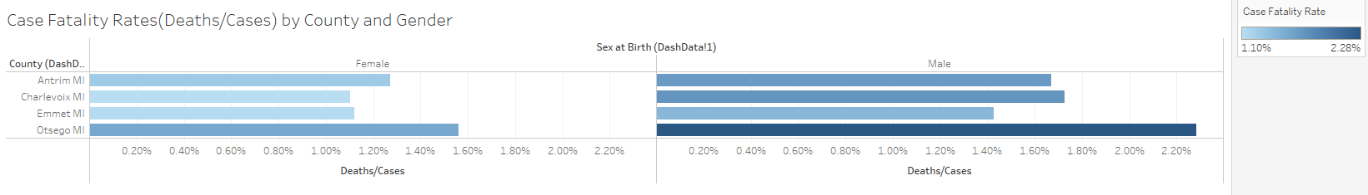
Case Fatality Rates by County and Gender
Males appear to higher case fatality rates among the counties compared to females! Otsego has the largest case fatality rate in men and women separately and combined compared to the other counties!

Slide 24
Resolution!
Visuals were recreated and improved with Tableau
Visual exploration with Tableau caught a preprocessing error
Finally, several unique qualities about this dataset were brought to the light during exploration
Gender, County, and Age Group appear to influence Case Fatality Rate and overall case numbers
Symptoms are not reported equitably whether experienced or not

Slide 25
Next Steps!
Continue to learn Tableau as it has proven to be a great tool!
Mention Tableau to supervisors as a viable alternative to Power BI
Work on data preprocessing quality control steps to prevent a future blunder such as the one that was found from occurring again

Slide 26

Thank you!!!

